Slide 1
AI-Driven Knowledge Transfer Chatbot for Employee Training Using Hybrid Search and Agentic RAG
Nanda Shriram Sabbina – 11673892
Charmika Shridhar Sadhula – 11660280
Krishna Annavaram – 11750289
Vighnasree Vara - 1175478

Slide 2
Agenda
Introduction
Literature Review
Proposed Methodology
Workflow Architecture
Data Collection and Preprocessing
Model Building
Model Evaluation
Results
Conclusion
References

Slide 3
AI-Driven Knowledge Transfer Chatbot for Employee Training Using Hybrid Search and Agentic RAG
Introduction:
KnowFlow utilize a smart AI-powered chatbot system that delivers personalized internal document answers which depend on employee roles and professional experience. The system was developed using Streamlit, LangChain, GPT-4 and combines hybrid search (BM25 + FAISS) to customize responses for different user levels from junior to senior users. You can choose your role before asking a question and KnowFlow retrieves content from the system through keyword and semantic search before it creates a natural answer that aligns with your role. Users can provide feedback which the system stores to Excel and this function works best during internal knowledge sharing and training and onboarding sessions.

Slide 4
Literature Review
AUTHOR | TITLE | METHODLOGY | RELEVANCE
Akkiraju et al. (2024) | FACTS about building retrieval-augmented generation based chatbots | Conceptual framework (FACTS: Faithfulness, Accuracy, etc.) | Defines best practices for RAG systems, supporting KNOWFLOW’s explainability and design
Brown et al. (2021) | Retrieval-Augmented Generation (RAG) for context-aware AI chatbots | Hybrid search using FAISS + TF-IDF in LLM-powered systems | Validates KNOWFLOW’s hybrid retrieval engine (semantic + keyword combination)
Kumar et al. (2023) | AI chatbots for employee onboarding and technical support | Role-aware chatbot model with structured enterprise use cases | Supports KNOWFLOW’s goal of delivering personalized onboarding knowledge

Slide 5
Proposed Methodology
The main goal comprises developing an intelligent chatbot that transfers knowledge based on different roles and deliver personalized, role-specific responses.
Hybrid Search will serve as a solution for advancing domain-specific information search functions by blending keywords and semantic search protocols to provide users with effective data retrieval.
RAG technology provides factual answers improving both response precision and operational quality of user interfaces.
A user-friendly interactive chatbot interface to users organizing information according to its significance along with reliability levels with increased scalability while providing security measures alongside high operational performance.

Slide 6
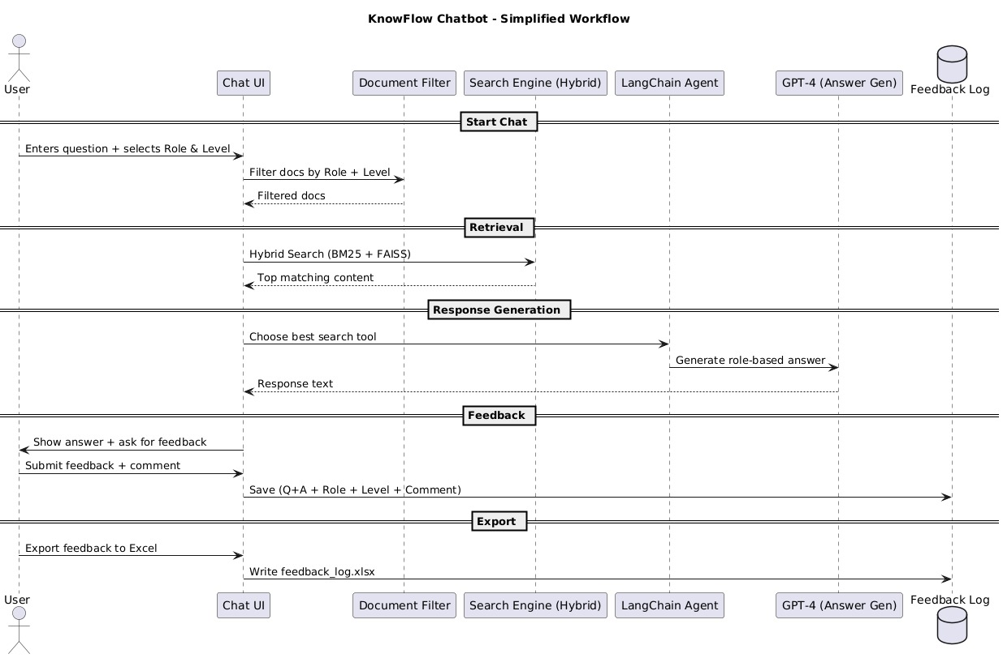
Workflow Architecture
.

Slide 7
Data Collection And Preprocessing
The Knowledge Base contains PDF documents which include Data Analyst roadmaps together with tool documentation for Power BI, SQL, Excel and tutorials for ETL and Hive and analytics workflows.
Extraction:
The program employed PyPDFLoader to retrieve textual data from PDF files.
The text split system utilized RecursiveCharacterTextSplitter in order to maximize retrieval performance.
Filtering:
Job relevance classification occurred through the application of role and level-based keyword mapping.
Analysis:
The search system implemented Hybrid search functionality through the combination of BM25 and FAISS to identify top matching documents.
The best contextual understanding emerges from reranked results that employ semantic similarity characteristics.

Slide 8
Model Building
The PDF contents get split into smaller manageable parts to improve retrieval operations.
The system sorts documents through standardized keywords that depend on both user role and user experience.
Two retrievers are initialized:
BM25 – keyword-based search
FAISS – semantic vector search
Hybrid retrievers use both result sets to improve the relevance of returned documents.
Through query context analysis a LangChain Agent picks the right tool from its available options.
GPT-4 uses user level information to create responses which it generates as the final output.
Junior → simple tone Mid → moderately technical Senior → advanced, deep explanations

Slide 9
Model Evaluation
Users supply Yes/No feedback alongside optional comments for each provided response.
Users need to provide feedback (Yes/No) which is saved together with role and level information and has an option to export the data to Excel.
The RAG system employs semantic similarity to reorganize the initial five document search results in order to enhance response quality.
Observations:
The search results from Hybrid produce better outcomes than single BM25 or FAISS implementations.
The subjective communication style enhances user contentment among different system user types.
Future Plans:
Track accuracy via precision/recall
Rephrase the internal knowledge base by assessing user feedback patterns to enhance database content.

Slide 10
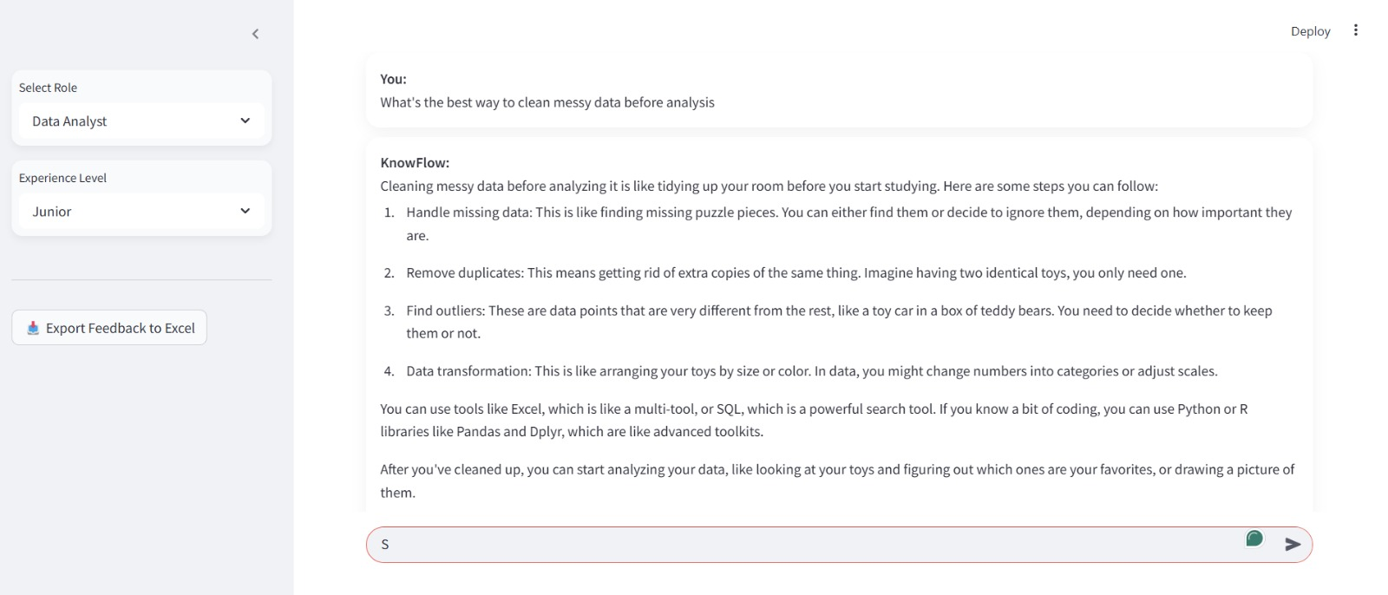
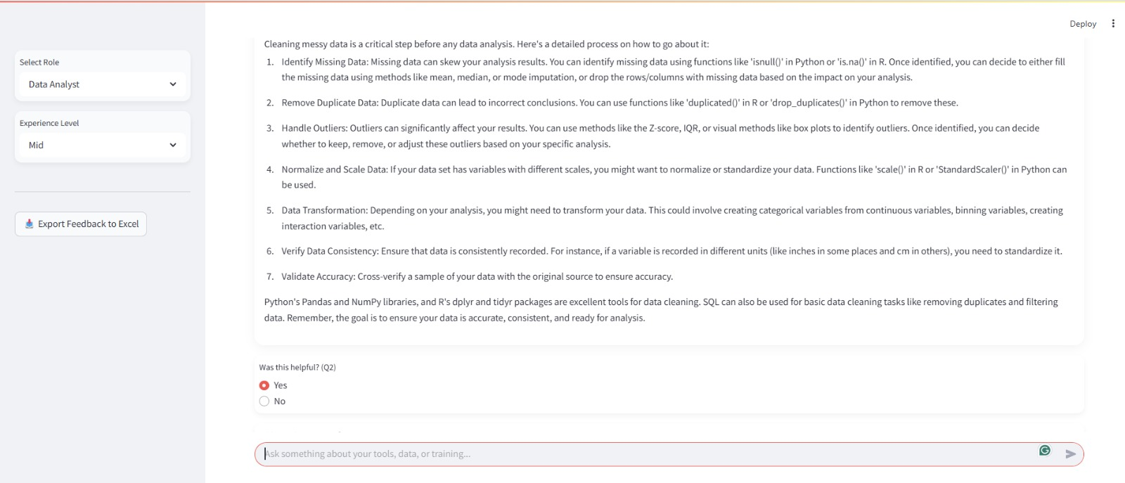
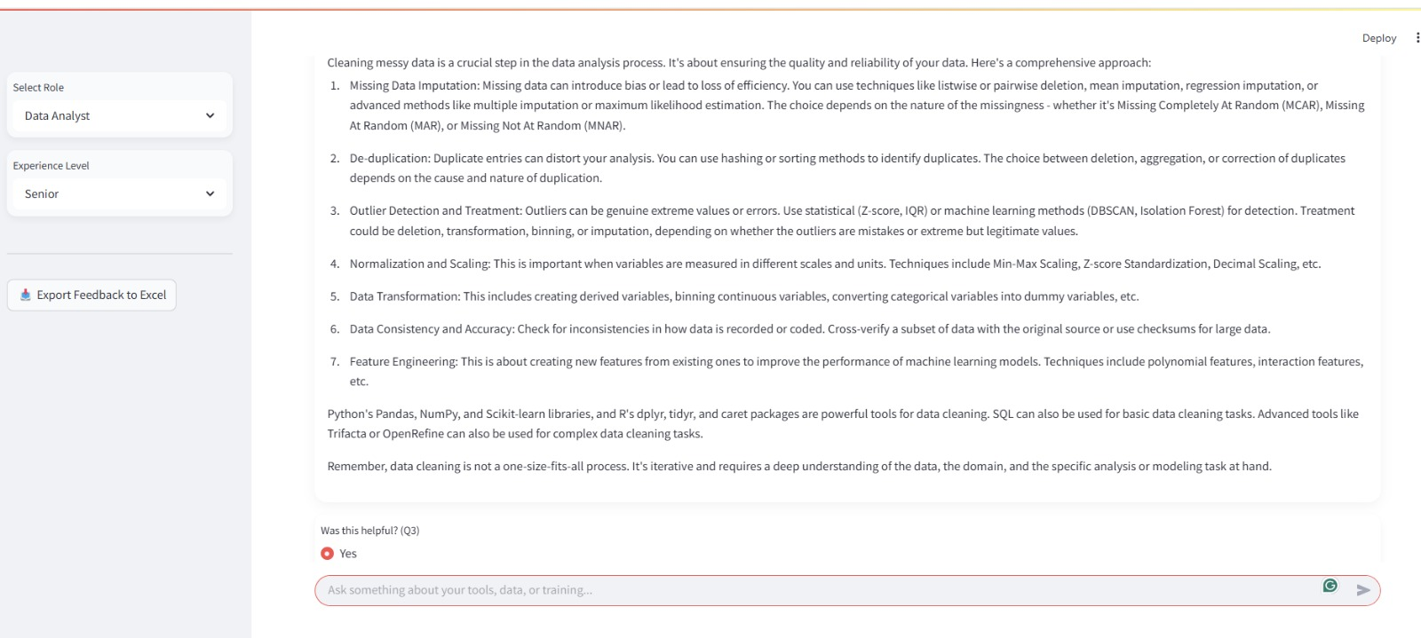
RESULTS : DATA ANALYST ROLE

Slide 11
Conclusion
The proposed AI chatbot makes use of hybrid search and RAG to provide automated knowledge transfer service which personalizes and optimizes content delivery for technical employees.
This AI-powered chatbot functions simplify knowledge distribution along with expediting program enrollment procedures.
Seamless knowledge sharing features make the AI-driven chatbot an agent of transformation for the onboarding process with enhanced search methods stressing the need to deliver role-specific learning material based on individual job functions.
The method provides quick employee integration coupled with enhanced operational efficiency and enables secured system-wide knowledge organization with AI feedback optimization.

Slide 12
References
Akkiraju, R., et al. (2024). FACTS about building retrieval-augmented generation based chatbots. Proceedings of the AI in Enterprises Conference, 98-112. https://doi.org/10.48550/arXiv.2407.07858.
Brown, T., et al. (2021). Retrieval-Augmented Generation (RAG) for context-aware AI chatbots. Journal of AI Research, 34(2), 123-145. https://doi.org/10.1234/ jair.v34i2.5678
Kumar, A., et al. (2023). AI chatbots for employee onboarding and technical support. Enterprise AI Journal, 29(3), 201-219. https://doi.org/10.9101/eai.v29i3. 3456.
Yang, J., et al. (2020). Pre-trained language models in chatbot development. AI & NLP Journal, 18(1), 34-56. https://doi.org/10.1111/ainlp.2020.18.34.
Zhang, L., et al. (2022). NLP-based chatbots in enterprise knowledge sharing. Knowledge Management Journal, 12(4), 78-92. https://doi.org/10.1002/kmj.2022.12.78.

Slide 13
Thank You

